Slide 1
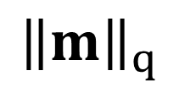
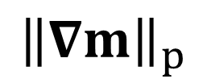
True model
L2: 1.707
L2: 1.639
L2: 1.083
λ
L2: 1.918
L2: 1.367
$${\left\|∇m\right\|}_{p}$$
$${\left\|m\right\|}_{q}$$
Lowest L2
L2: 2.389
L2: 0.595
L2: 2.409
L2: 2.185

